Slide 1
Year 7
Environment and Feeding Relationships

Slide 2
Objectives
In today’s lesson you will learn:
About the different habitats organisms live in.
How to describe the environment of different habitats.
About the special adaptations that organisms have to help them live in their habitat.

Slide 3
Key words
Habitat
Microhabitat
Environment
Adapted
Adaptation
Community

Slide 4
Habitats
What is a habitat?
The place where an organism lives is called a habitat.
Here are some examples of habitats

Slide 5
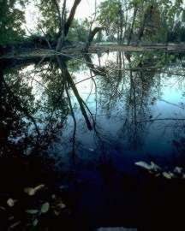
Pond

Slide 6
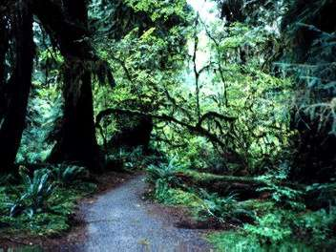
Woodland

Slide 7
Hedge

Slide 8
Different organisms live in different habitats. Can you name two organisms for each of the habitats?

Slide 9
Pond

Slide 10
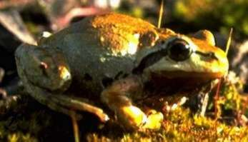
A frog is an amphibian because it lives in water and on land.

Slide 11
Fish live and breathe in water. This is a stickleback.

Slide 12
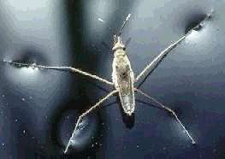
Pond skaters live on the water surface.

Slide 13
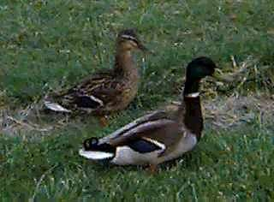
Ducks are birds that have waterproof feathers. They live on a pond and on land.

Slide 14
Woodland

Slide 15
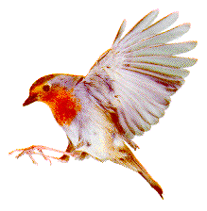
Birds
Birds, such as this robin, make their nests in trees and hedges.

Slide 16
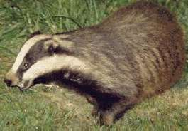
A badger makes it’s home under the ground. It sleeps during the day and is awake at night.

Slide 17
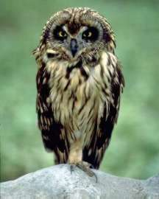
Owl
An Owl is a bird that sleeps during the day and is awake at night.

Slide 18
Hedge

Slide 19
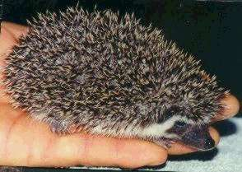
A hedgehog is a prickly mammal that sleeps through the winter.

Slide 20
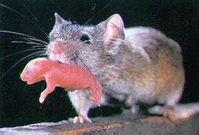
Mice are small furry mammals.

Slide 21
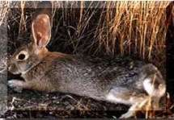
A rabbit burrows under the ground to make a warren to live in.

Slide 22
Environment
The word environment is used to describe what a habitat is like.
For example, a desert is dry and hot during the day.

Slide 23
Adaptations
Adaptations are features which organisms have that help them survive in their habitat
Here are some examples ……………

Slide 24
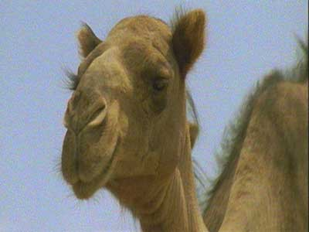
Dromedary camel, Arabian camel, one-humped camel

Slide 25
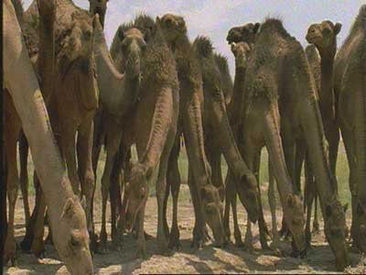
Habitat: They live South West Asia and North Africa desert regions. They are also live in Australia. They live for 40-50 years. Length: 2.2-3.4m, Tail length: 50cm, Height at hump: 1.9-2.3m, Weight: 450-550kg

Slide 26
A camels habitat is a desert

Slide 27
Adaptations: They are desert animals and have numerous adaptations for life in an arid habitat.
The hump stores fat, which they are able to draw upon for water.
They have webbed feet (to prevent sinking in the sand);
They can close their nostrils and they have a double row of eyelashes to keep out the sand.
They can endure long periods without drinking - up to 17 days.
When they do drink, they can take up to 136 litres (30 gallons) at a time. By producing dry faeces and little urine, they can conserve water.
Their body temperature can rise 6-8 degree Celsius before sweating.

Slide 28
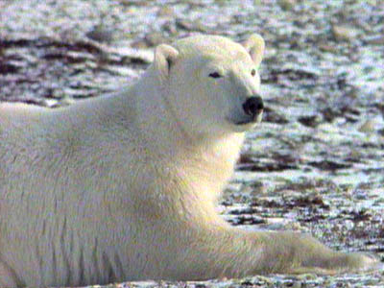

Slide 29
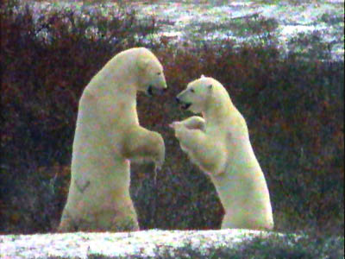

Slide 30
The polar bear is the largest land carnivore and has a reputation as the only animal that actively hunts humans.
Live up to 25 years.
Body length: male: 240-260cm, female: 190-210cm. Weight: male: 400-600kg, female: 200-300kg. They are the largest species of bear and the largest land carnivore.
Habitat They spend most of their time on Arctic ice floes, and when they are on the shore they remain near the water. Polar bears are found throughout the Arctic.
Adaptations: They are strong swimmers and have many adaptations for an aquatic environment
They are well insulated with fat,
Their nostrils close and their ears are held close to their head when underwater.
Their feet are partially webbed.
They have a remarkable sense of smell and can detect a carcass from 3km away.
They have large, furry feet that act as snowshoes.
Their creamy-white fur is dense and water-repellent, enabling them to shake dry after swimming.

Slide 31
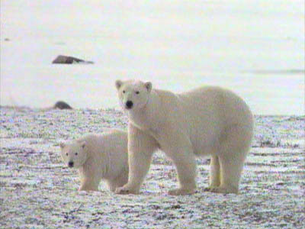

Slide 32
This powerpoint was kindly donated to www.worldofteaching.com
http://www.worldofteaching.com is home to over a thousand powerpoints submitted by teachers. This is a completely free site and requires no registration. Please visit and I hope it will help in your teaching.

